Slide 1
Ggplot2 and interactive graphics with R
Christophe Ladroue
SECTION 07
VIDEO 05
Publishing your work
www.PacktPub.com

Slide 2
Publishing your app
On the internet (dedicated server)
With a dedicated server, the user doesn’t have to use R. They only need an internet
connection and a browser.
On the users' machine
The user needs to have R and Shiny installed, as well as all the packages your
app needs.

Slide 3
Shiny app on a dedicated server
Your own server
If you have access to a Linux machine, you can install the shiny server yourself.
Advantage: you have complete control of the source.
Drawback: it takes some time and expertise to set up and maintain.
An RStudio-hosted server
You can open an account on a shiny server provided by Rstudio.
Advantage: easy to setup.
Drawback: you have to upload your source code to their server.

Slide 4
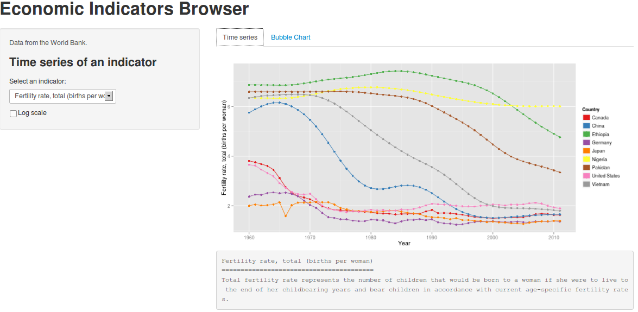
In this video we took a look at
a number of ways to share our work with the world or some colleagues, either by using a dedicated server or by sharing the code in a zip file or on github.
Next: building an interactive dashboard

